Slide 1
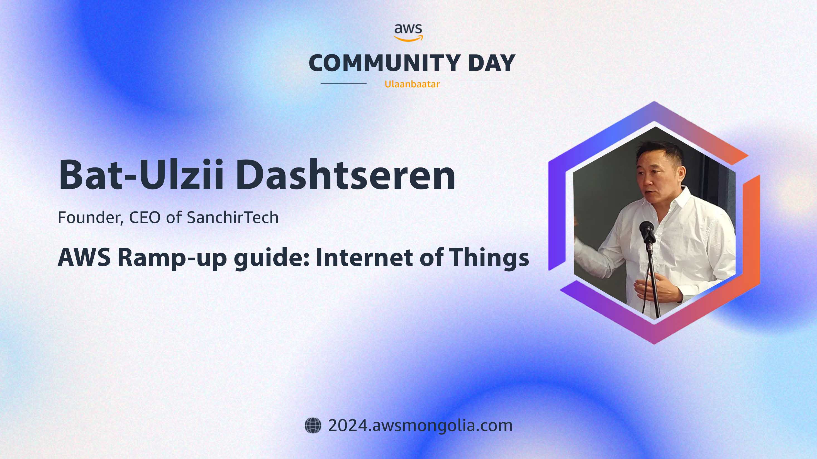

Slide 2













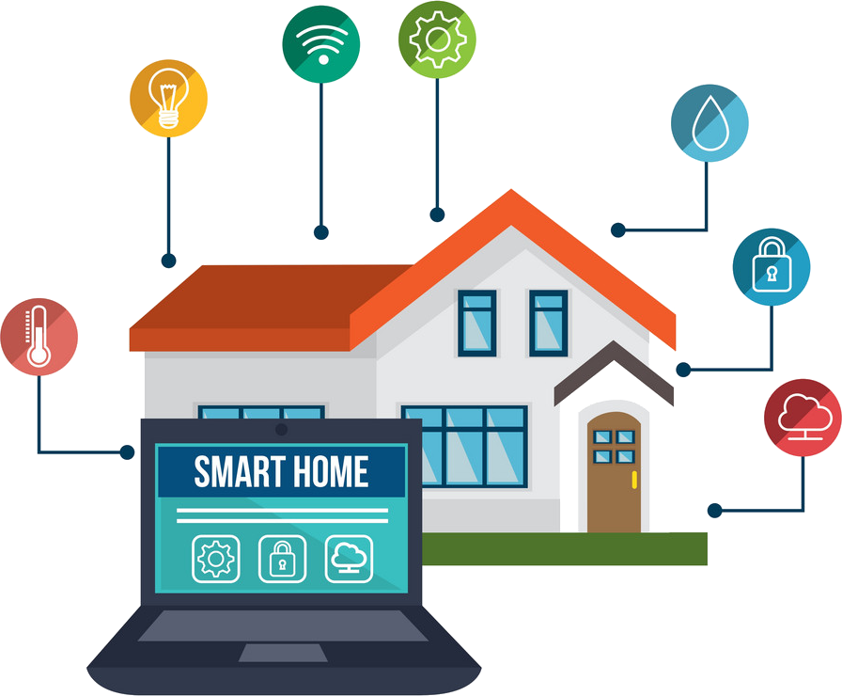





Internet of Things
Kinesis
S3
IoTs
Industrial IoT
MQTT
IoT Core
IoT Device Defender
Device SDK
IoT Events
SNS
OPC UA
MQTT
GreenGrass
IoT Core
IoT Analytics
QuickSight
MQTT
Lambda
Device
SiteWise
SiteWise
SageMaker
DynamoDB

Slide 3







Internet of Things
IoT sensor
443, 8883 – What’s the difference?
ALPN – One port to rule them all
Application Layer Protocol Negotiation (ALPN) is an extension to TLS defined by RFC 7301 that is supported by many of the most common TLS implementations.
IoT policy
Device gateway
AWS IoT Core for LoRaWAN protocol
IoT certificate
IoT actuator
Device gateway
IoT rule

Slide 4
Internet of Threads
Ensure your device’s TLS client implementation supports the ALPN extension.
Consult the manual to be certain, but this Wikipedia page provides a handy list.
Amazon FreeRTOS source code supports the ALPN extension.
Register your device with AWS IoT Core by creating, activating, and downloading a certificate or bring your own certificate.
Configure the ALPN extension on your device with the “x-amzn-mqtt-ca” protocol*.
Connect to AWS IoT Core on port 443.

Slide 5
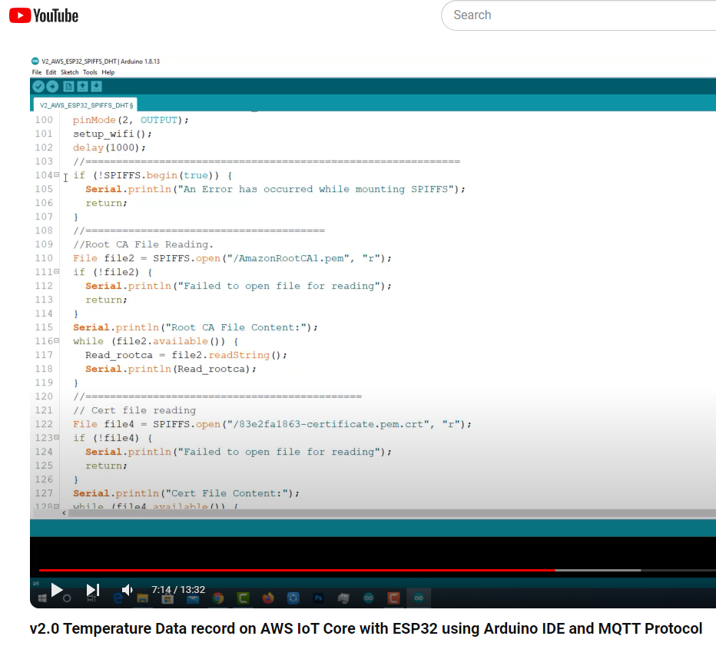
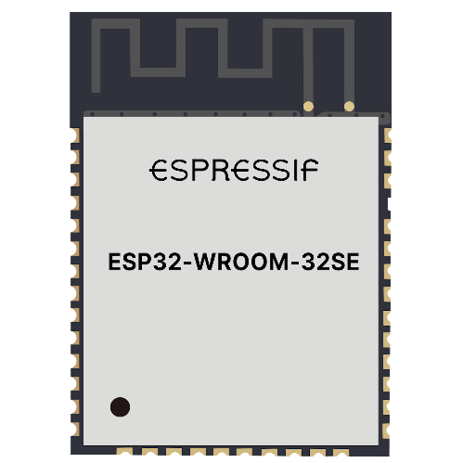
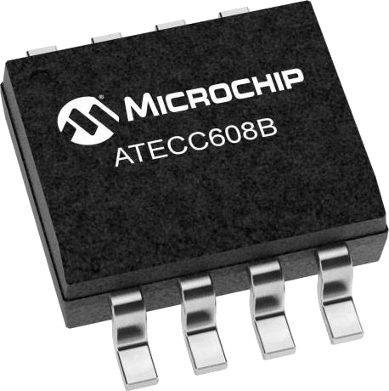
Internet of Threads
Internet of Things
Pre-provisioned secure
element for TLS system
Builtin secure element
Certificate & Keys - naked

Slide 6
Instant Startup Company
CleanSense is an innovative startup utilizing PIR movement sensors and PM2.5 air quality sensors, integrated with AWS infrastructure, to provide instant and efficient cleaning services by dynamically monitoring and responding to the cleanliness of spaces in real-time.

Slide 7


CleanSense LLC
Rest Room
PIR movement
Amazon Location Service
Amazon Cognito
DynamoDB
AIR PM2.5
AWS IoT Core
IoT rule
AWS IoT Events
Amazon Simple Notification Service SNS
Cleaner/Worker
RFID reader

Slide 8
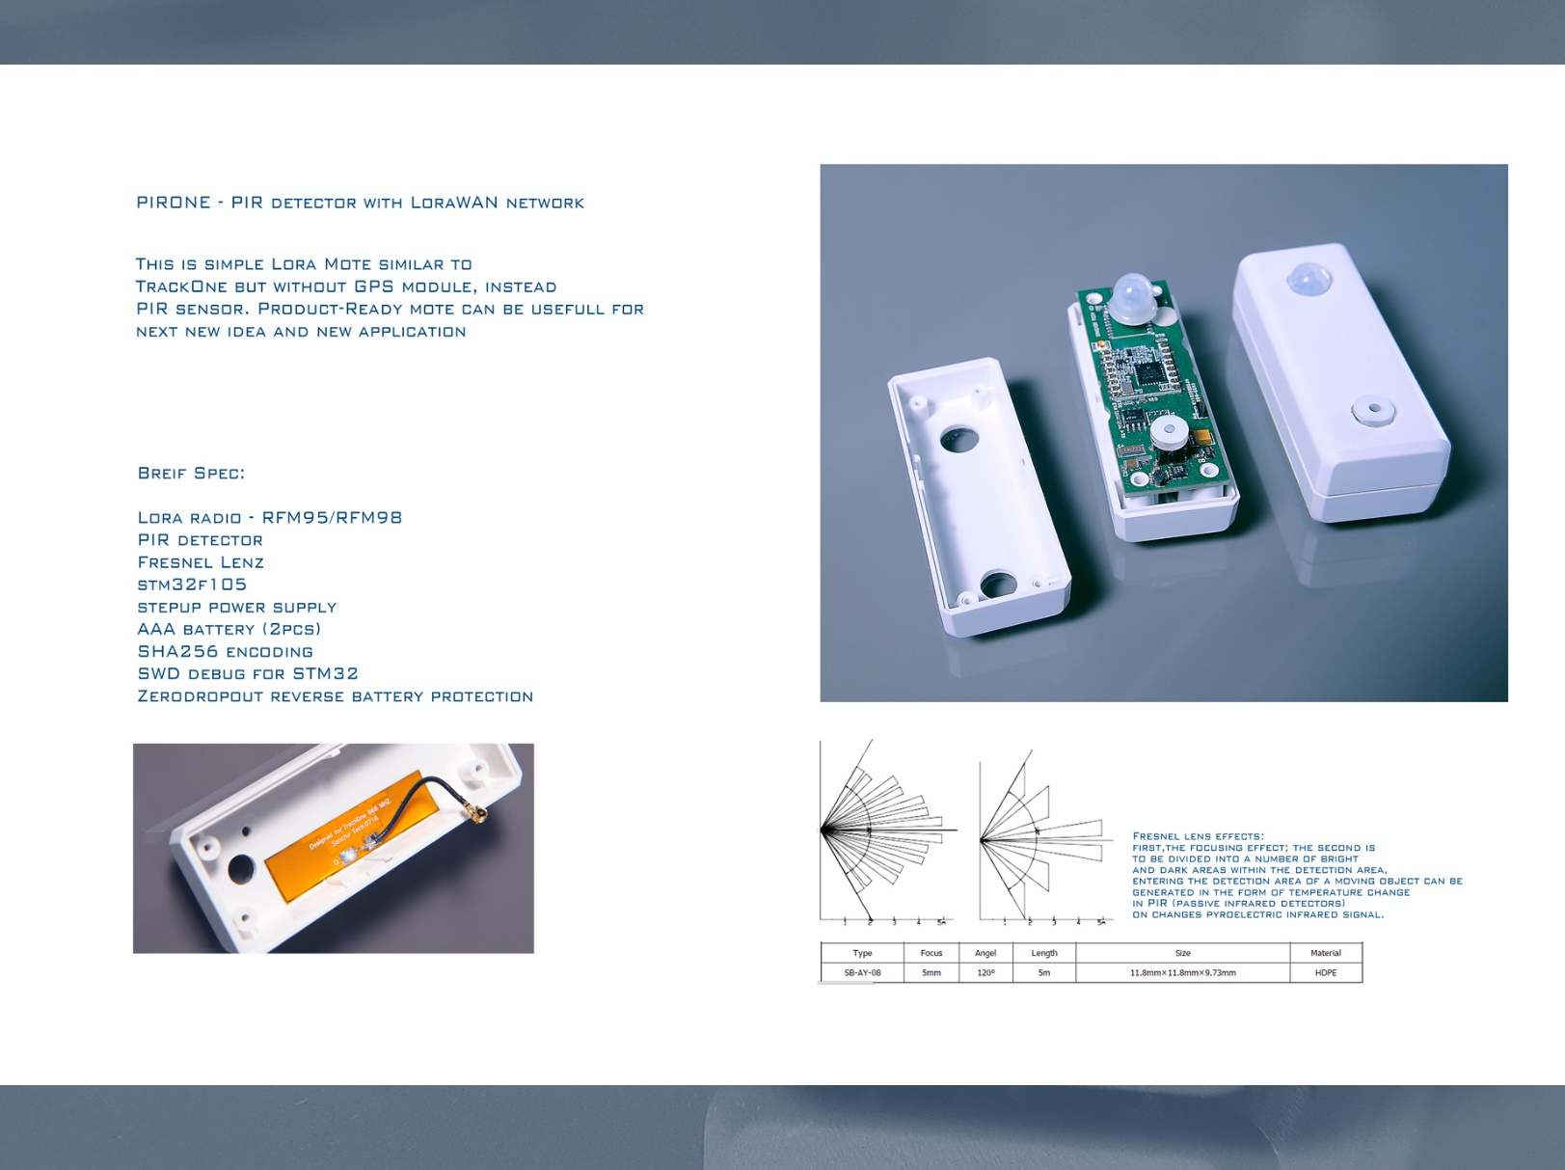

Slide 9
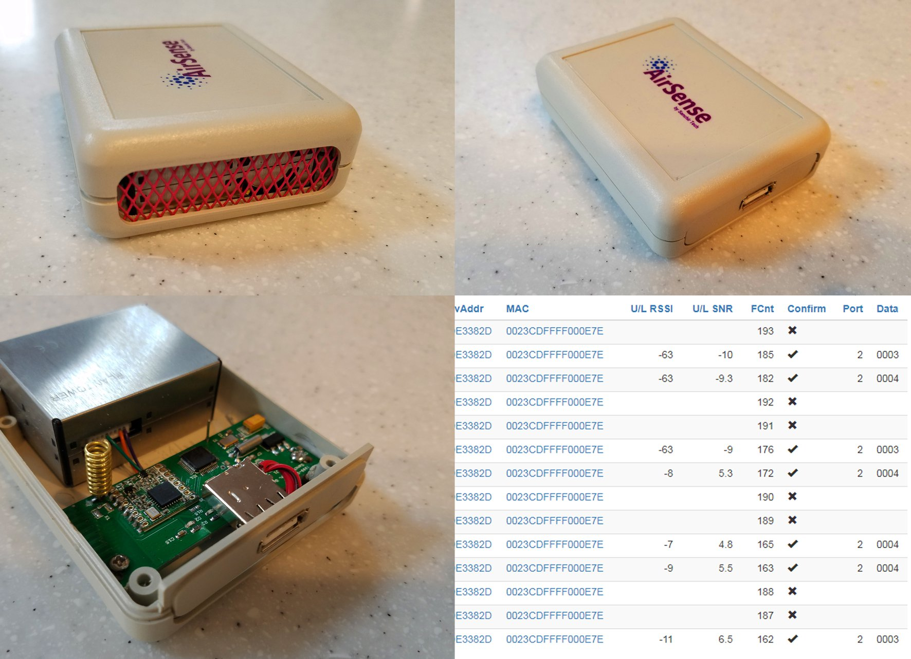

Slide 10
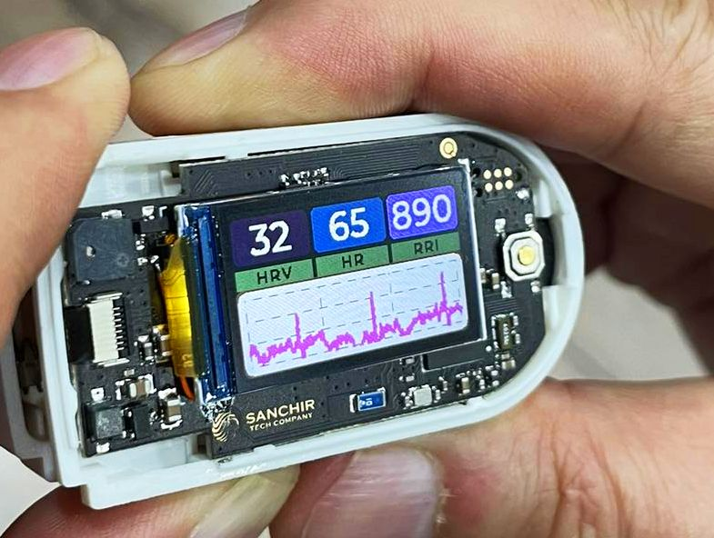
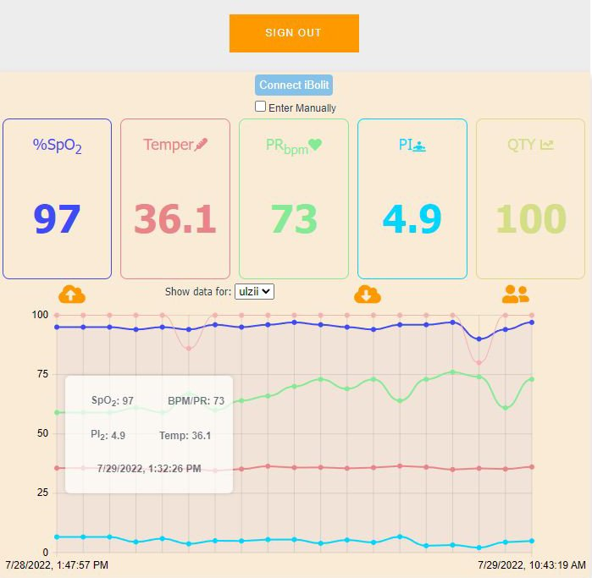
IoT & Serverless power up telemedicine. The iBolit

Slide 11




HTML, CSS, JS
Measurements
Authenticate
Amazon Cognito
API calls
Amazon API Gateway
AWS Lambda
Amazon DynamoDB

Slide 12


Endpoints
Lambdas
DynamoDB
Post/levels
AddLevels
Level Table
Get/levels
AWS Amplify
FetchLevels
Levels Table
Post/levels/shared
FetchShared
User Levels
Access Table

Slide 13
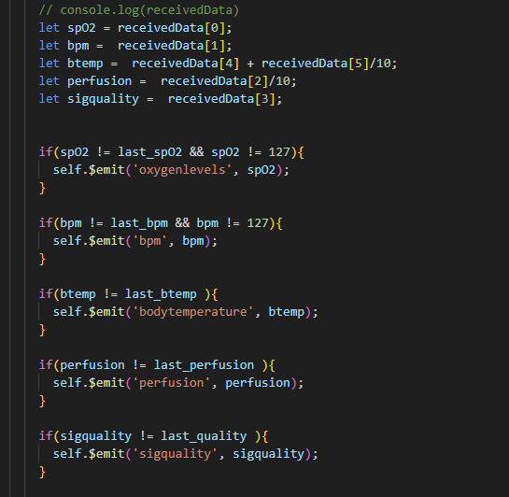
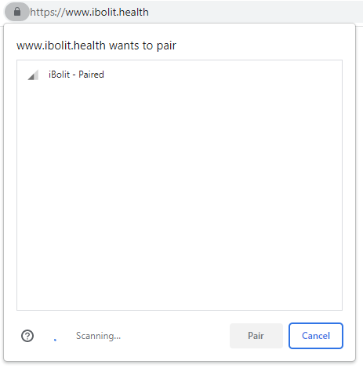

Slide 14
Thank you!
https://github.com/SanchirTechnologies/awscommunityday24

